Slide 1

Recurrent Neural Networks
deeplearning.ai

Slide 2
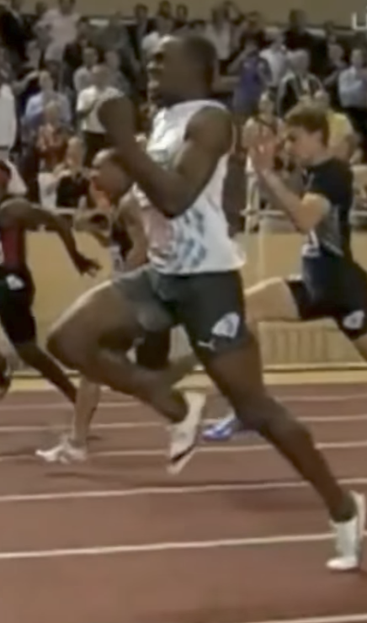
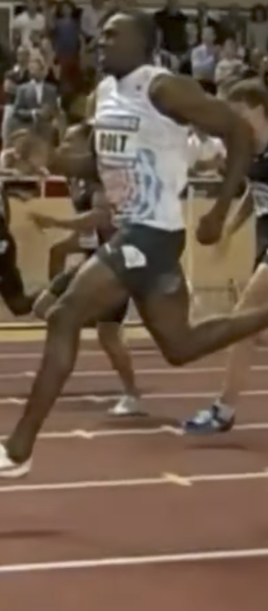
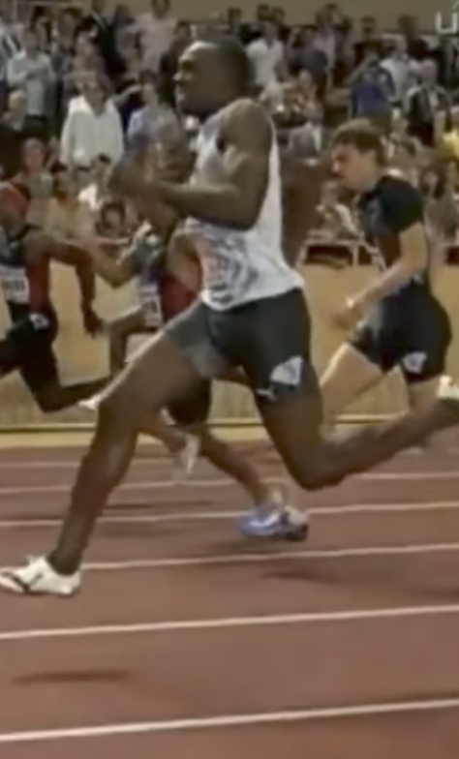
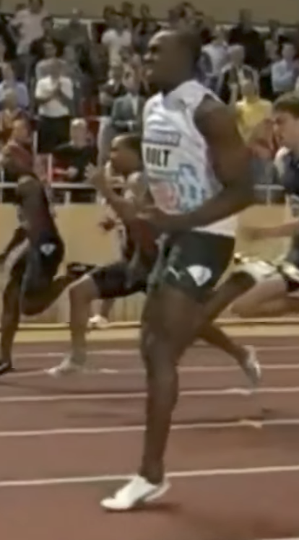
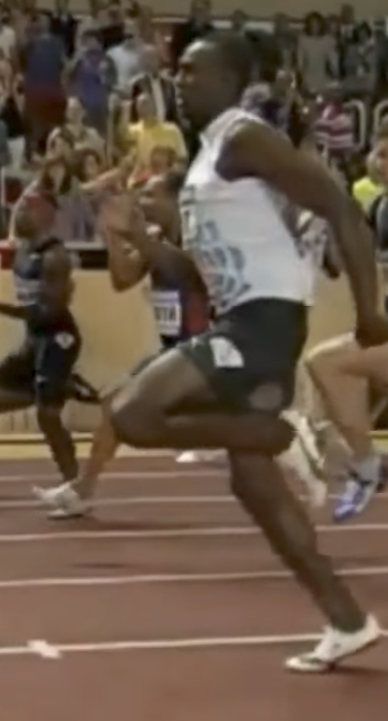
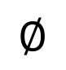
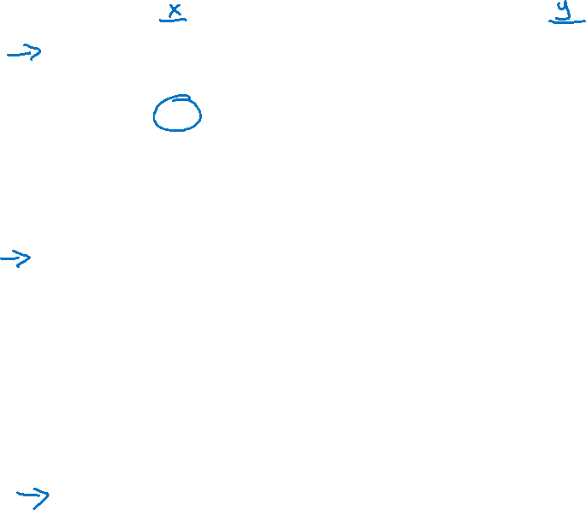
Examples of sequence data
“The quick brown fox jumped over the lazy dog.”
Speech recognition
Music generation
$$∅$$
Sentiment classification
“There is nothing to like in this movie.”
DNA sequence analysis
AGCCCCTGTGAGGAACTAG
AGCCCCTGTGAGGAACTAG
Machine translation
Voulez-vous chanter avec moi?
Do you want to sing with me?
Plasmid sequence AP4 Oligo
Video activity recognition
Running
Name entity recognition
Yesterday, Harry Potter met Hermione Granger.
Yesterday, Harry Potter met Hermione Granger.

Slide 3
Motivating example
x:
Harry Potter and Hermione Granger invented a new spell.

Slide 4
Representing words
x:
Harry Potter and Hermione Granger invented a new spell.
$$x^{<1>}$$
$$x^{<2>}$$
$$x^{<3>}$$
$$⋯$$
$$x^{<9>}$$

Slide 5
Representing words
x:
Harry Potter and Hermione Granger invented a new spell.
$$x^{<1>}$$
$$x^{<2>}$$
$$x^{<3>}$$
$$⋯$$
$$x^{<9>}$$
And = 367
Invented = 4700
A = 1
New = 5976
Spell = 8376
Harry = 4075
Potter = 6830
Hermione = 4200
Gran… = 4000

Slide 6
Why not a standard network?
$$x^{<1>}$$
$$y^{<1>}$$
$$x^{<2>}$$
$$y^{<2>}$$
$$⋮$$
$$⋮$$
$$⋮$$
$$⋮$$
$$x^{<T_{x}>}$$
$$y^{<T_{y}>}$$
Problems:
- Inputs, outputs can be different lengths in different examples.
- Doesn’t share features learned across different positions of text.

Slide 7
Recurrent Neural Networks
He said, “Teddy Roosevelt was a great President.”
He said, “Teddy bears are on sale!”

Slide 8
Forward Propagation
$${\hat{y}}^{<1>}$$
$${\hat{y}}^{<2>}$$
$${\hat{y}}^{<3>}$$
$${\hat{y}}^{<T_{y}>}$$
$$a^{<1>}$$
$$a^{<2>}$$
$$a^{<T_{x}−1>}$$
$$a^{<0>}$$
$$⋯$$
$$x^{<1>}$$
$$x^{<2>}$$
$$x^{<3>}$$
$$x^{<T_{x}>}$$

Slide 9
Simplified RNN notation
$$a^{<t>}=g(W_{aa}a^{<t−1>}+W_{ax}x^{<t>}+b_{a})$$
$${\hat{y}}^{<t>}=g(W_{ya}a^{<t>}+b_{y})$$

Slide 10
Forward propagation and backpropagation
$${\hat{y}}^{<1>}$$
$${\hat{y}}^{<2>}$$
$${\hat{y}}^{<3>}$$
$${\hat{y}}^{<T_{y}>}$$
$$a^{<1>}$$
$$a^{<2>}$$
$$a^{<T_{x}−1>}$$
$$a^{<0>}$$
$$⋯$$
$$x^{<1>}$$
$$x^{<2>}$$
$$x^{<3>}$$
$$x^{<T_{x}>}$$

Slide 11
Forward propagation and backpropagation
$$ℒ^{<t>}\left({\hat{y}}^{<t>},y^{<t>}\right)=$$
Backpropagation through time

Slide 12
Examples of sequence data
“The quick brown fox jumped over the lazy dog.”
Speech recognition
Music generation
$$∅$$
Sentiment classification
“There is nothing to like in this movie.”
DNA sequence analysis
AGCCCCTGTGAGGAACTAG
AGCCCCTGTGAGGAACTAG
Machine translation
Voulez-vous chanter avec moi?
Do you want to sing with me?
Plasmid sequence AP4 Oligo
Video activity recognition
Running
Name entity recognition
Yesterday, Harry Potter met Hermione Granger.
Yesterday, Harry Potter met Hermione Granger.

Slide 13
Examples of RNN architectures

Slide 14
Examples of RNN architectures

Slide 15
Summary of RNN types
$${\hat{y}}^{<1>}$$
$${\hat{y}}^{<1>}$$
$${\hat{y}}^{<2>}$$
$${\hat{y}}^{<T_{y}>}$$
$${\hat{y}}^{ }$$
$$a^{<0>}$$
$$a^{<0>}$$
$$⋯$$
$$a^{<0>}$$
$$⋯$$
$$x^{<1>}$$
$$x$$
$$x^{<1>}$$
$$x^{<2>}$$
$$x^{<T_{x}>}$$
One to one
One to many
Many to one
$${\hat{y}}^{<1> }$$
$${\hat{y}}^{<2> }$$
$${{\hat{y}}^{<1>}}^{ }$$
$${{\hat{y}}^{<T_{y}>}}^{ }$$
$${\hat{y}}^{<T_{y}> }$$
$$a^{<0>}$$
$$⋯$$
$$⋯$$
$$⋯$$
$$a^{<0>}$$
$$⋯$$
$$x^{<1>}$$
$$x^{<T_{x}>}$$
$$x^{<1>}$$
$$x^{<2>}$$
$$x^{<T_{x}>}$$
Many to many
Many to many

Slide 16
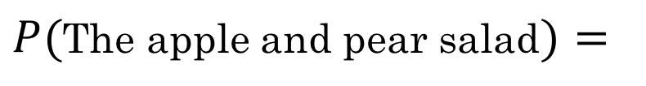
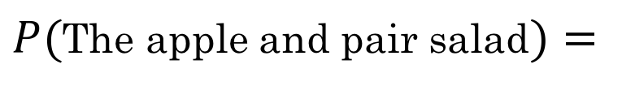
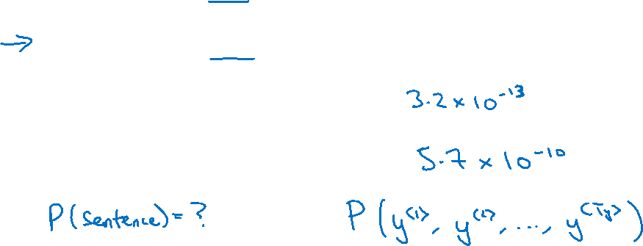
What is language modelling?
Speech recognition
The apple and pair salad.
The apple and pear salad.
$P($The apple and pair salad$)=$
$P($The apple and pear salad$)=$

Slide 17
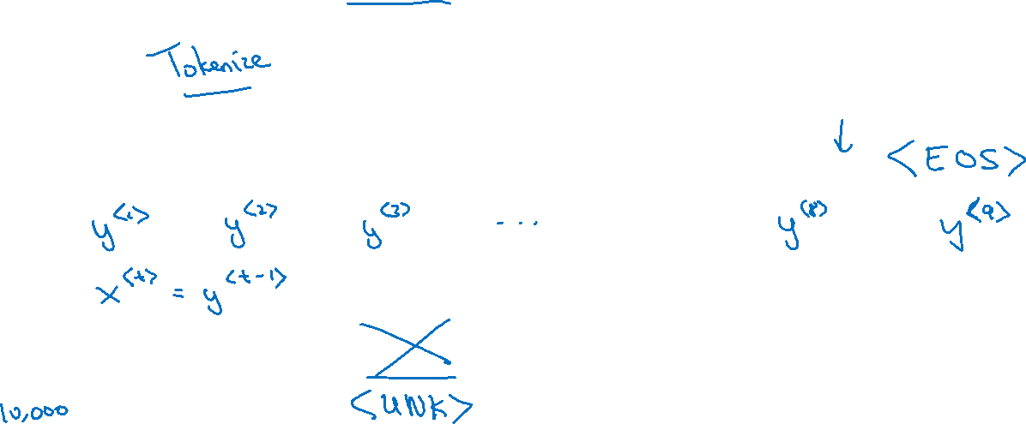
Language modelling with an RNN
Training set: large corpus of english text.
Cats average 15 hours of sleep a day.
The Egyptian Mau is a bread of cat. <EOS>

Slide 18
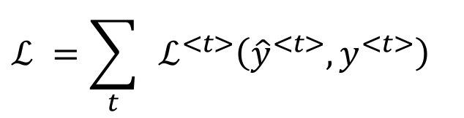
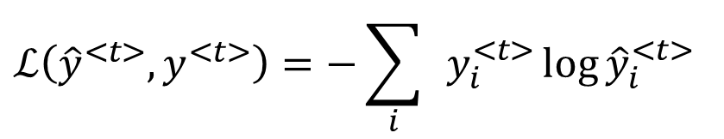
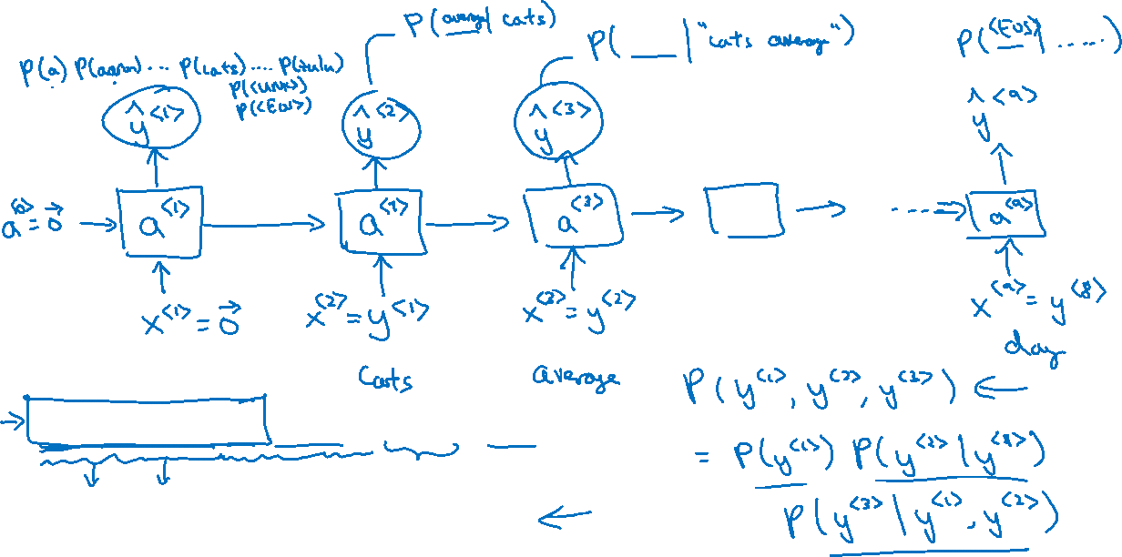
RNN model
Cats average 15 hours of sleep a day. <EOS>
$$ℒ\left({\hat{y}}^{<t>},y^{<t>}\right)=−\sum_{i}{ }y_{i}^{<t>}{\log{\hat{y}}}_{i}^{<t>}$$
$$ℒ^{ }=\sum_{t}{ }ℒ^{<t>}\left({\hat{y}}^{<t>},y^{<t>}\right)$$

Slide 19
Recurrent Neural Networks
Sampling novel sequences
deeplearning.ai

Slide 20
Sampling a sequence from a trained RNN
$${\hat{y}}^{<1> }$$
$${\hat{y}}^{<2> }$$
$${\hat{y}}^{<3> }$$
$${\hat{y}}^{<T_{y}> }$$
$$a^{<0>}$$
$$a^{<1>}$$
$$a^{<2>}$$
$$a^{<3>}$$
$$⋯$$
$$a^{<T_{y}>}$$
$$x^{<1>}$$
$$y^{<1>}$$
$$y^{<2>}$$
$$y^{<T_{x}−1>}$$

Slide 21
Character-level language model
Vocabulary = [a, aaron, …, zulu, <UNK>]
$${\hat{y}}^{<1> }$$
$${\hat{y}}^{<2> }$$
$${\hat{y}}^{<3> }$$
$${\hat{y}}^{<T_{y}> }$$
$$a^{<0>}$$
$$a^{<1>}$$
$$a^{<2>}$$
$$a^{<3>}$$
$$⋯$$
$$a^{<T_{y}>}$$
$$x^{<1>}$$
$${\hat{y}}^{<1> }$$
$${\hat{y}}^{<2> }$$
$${\hat{y}}^{<T_{x}−1> }$$

Slide 22
Sequence generation
News
Shakespeare
President enrique peña nieto, announced sench’s sulk former coming football langston paring.
“I was not at all surprised,” said hich langston.
“Concussion epidemic”, to be examined.
The gray football the told some and this has on the uefa icon, should money as.
The mortal moon hath her eclipse in love.
And subject of this thou art another this fold.
When besser be my love to me see sabl’s.
For whose are ruse of mine eyes heaves.

Slide 23
Recurrent Neural Networks
Vanishing gradients with RNNs
deeplearning.ai

Slide 24
Vanishing gradients with RNNs
$${\hat{y}}^{<1> }$$
$${\hat{y}}^{<2> }$$
$${\hat{y}}^{<3> }$$
$${\hat{y}}^{<T_{y}> }$$
$$a^{<0>}$$
$$a^{<1>}$$
$$a^{<2>}$$
$$a^{<3>}$$
$$⋯$$
$$a^{<T_{y}>}$$
$$x^{<1>}$$
$$x^{<2>}$$
$$x^{<3>}$$
$$x^{<T_{x}>}$$
$$x^{ }$$
$$⋯$$
$${\hat{y}}^{ }$$
$$⋮$$
$$⋮$$
$$⋮$$
$$⋮$$
$$⋮$$
$$⋮$$
$$⋮$$
Exploding gradients.

Slide 25
Recurrent Neural Networks
Gated Recurrent Unit (GRU)
deeplearning.ai

Slide 26
RNN unit
$$a^{<t>}=g(W_{a}\left[a^{<t−1>}, x^{<t>}\right]+b_{a})$$
$${\hat{y}}^{<1> }$$
$$a^{<0>}$$
$$a^{<1>}$$
$$x^{<1>}$$

Slide 27
GRU (simplified)
The cat, which already ate …, was full.
[Cho et al., 2014. On the properties of neural machine translation: Encoder-decoder approaches]
[Chung et al., 2014. Empirical Evaluation of Gated Recurrent Neural Networks on Sequence Modeling]

Slide 28
Full GRU
$${\tilde{c}}^{<t>}=\tanh{(W_{c}[}$$
$$c^{<t−1>},x^{<t>}]+b_{c})$$
$$Γ_{u}=σ{(W_{u}\left[ c^{<t−1>},x^{<t>}\right]+b_{u})}$$
$$c^{<t>}=Γ_{u}{∗{\tilde{c}}^{<t>}+\left(1−Γ_{u}\right)+c^{<t−1>}}$$
The cat, which ate already, was full.

Slide 29
Recurrent Neural Networks
LSTM (long short term memory) unit
deeplearning.ai

Slide 30
GRU and LSTM
GRU
LSTM
$${\tilde{c}}^{<t>}=\tanh{(W_{c}\left[Γ_{r}∗c^{<t−1>},x^{<t>}\right]+b_{c})}$$
$$Γ_{u}=σ{(W_{u}\left[ c^{<t−1>},x^{<t>}\right]+b_{u})}$$
$$Γ_{r}=σ{(W_{r}\left[ c^{<t−1>},x^{<t>}\right]+b_{r})}$$
$$c^{<t>}=Γ_{u}{∗{\tilde{c}}^{<t>}+\left(1−Γ_{u}\right)∗c^{<t−1>}}$$
$$a^{<t>}=c^{<t>}$$
[Hochreiter & Schmidhuber 1997. Long short-term memory]

Slide 31
LSTM units
GRU
LSTM
$${\tilde{c}}^{<t>}=\tanh{(W_{c}\left[Γ_{r}∗c^{<t−1>},x^{<t>}\right]+b_{c})}$$
$${\tilde{c}}^{<t>}=\tanh{(W_{c}\left[a^{<t−1>},x^{<t>}\right]+b_{c})}$$
$$Γ_{u}=σ{(W_{u}\left[ c^{<t−1>},x^{<t>}\right]+b_{u})}$$
$$Γ_{u}=σ{(W_{u}\left[ a^{<t−1>},x^{<t>}\right]+b_{u})}$$
$$Γ_{r}=σ{(W_{r}\left[ c^{<t−1>},x^{<t>}\right]+b_{r})}$$
$$Γ_{f}=σ{(W_{f}\left[ a^{<t−1>},x^{<t>}\right]+b_{f})}$$
$$c^{<t>}=Γ_{u}{∗{\tilde{c}}^{<t>}+\left(1−Γ_{u}\right)∗c^{<t−1>}}$$
$$Γ_{o}=σ{(W_{o}\left[ a^{<t−1>},x^{<t>}\right]+b_{o})}$$
$$a^{<t>}=c^{<t>}$$
$$c^{<t>}={Γ_{u}∗{\tilde{c}}^{<t>}+Γ_{f}∗c^{<t−1>}}$$
$$a^{<t>}=Γ_{o}∗c^{<t>}$$
[Hochreiter & Schmidhuber 1997. Long short-term memory]

Slide 32
LSTM in pictures
$$y^{<t>}$$
$${\tilde{c}}^{<t>}=\tanh{(W_{c}\left[a^{<t−1>},x^{<t>}\right]+b_{c})}$$
softmax
$$a^{<t>}$$
$$Γ_{u}=σ{(W_{u}\left[ a^{<t−1>},x^{<t>}\right]+b_{u})}$$
-
-
$$c^{<t−1>}$$
$$c^{<t>}$$
-
*
$$⨁$$
-
$$Γ_{f}=σ{(W_{f}\left[ a^{<t−1>},x^{<t>}\right]+b_{f})}$$
$$c^{<t>}$$
*
tanh
$$Γ_{o}=σ{(W_{o}\left[ a^{<t−1>},x^{<t>}\right]+b_{o})}$$
$$a^{<t−1>}$$
*
$$a^{<t>}$$
$$f^{<t>}$$
$$i^{<t>}$$
$${\tilde{c}}^{<t>}$$
$$o^{<t>}$$
$$a^{<t>}$$
$$c^{<t>}={Γ_{u}∗{\tilde{c}}^{<t>}+Γ_{f}∗c^{<t−1>}}$$
forget gate
update gate
tanh
output gate
$$a^{<t>}=Γ_{o}∗c^{<t>}$$
$$x^{<t>}$$
$$y^{<1>}$$
$$y^{<2>}$$
$$y^{<3>}$$
softmax
softmax
softmax
$$a^{<1>}$$
$$a^{<2>}$$
-
$$c^{<2>}$$
$$a^{<3>}$$
-
-
$$c^{<1>}$$
-
-
$$c^{<3>}$$
-
-
-
-
-
-
$$c^{<0>}$$
*
$$⨁$$
-
$$c^{<1>}$$
*
$$⨁$$
$$c^{<2>}$$
*
$$⨁$$
$$a^{<0>}$$
$$a^{<1>}$$
$$a^{<2>}$$
$$a^{<2>}$$
$$a^{<1>}$$
$$a^{<3>}$$
$$x^{<1>}$$
$$x^{<2>}$$
$$x^{<3>}$$

Slide 33
Recurrent Neural Networks
Bidirectional RNN
deeplearning.ai

Slide 34
Getting information from the future
He said, “Teddy bears are on sale!”
He said, “Teddy Roosevelt was a great President!”
$${\hat{y}}^{<1> }$$
$${\hat{y}}^{<2> }$$
$${\hat{y}}^{<3> }$$
$${\hat{y}}^{<4> }$$
$${\hat{y}}^{<5> }$$
$${\hat{y}}^{<6> }$$
$${\hat{y}}^{<7> }$$
$$a^{<0>}$$
$$a^{<1>}$$
$$a^{<2>}$$
$$a^{<3>}$$
$$a^{<4>}$$
$$a^{<5>}$$
$$a^{<6>}$$
$$a^{<7>}$$
$$x^{<1>}$$
$$x^{<2>}$$
$$x^{<3>}$$
$$x^{<4>}$$
$$x^{<5>}$$
$$x^{<6>}$$
$$x^{<7>}$$
He said, “Teddy bears are on sale!”

Slide 35
Bidirectional RNN (BRNN)

Slide 36
Recurrent Neural Networks
Deep RNNs
deeplearning.ai

Slide 37
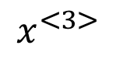
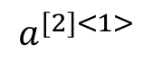
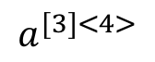
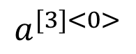
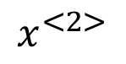
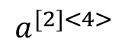
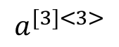
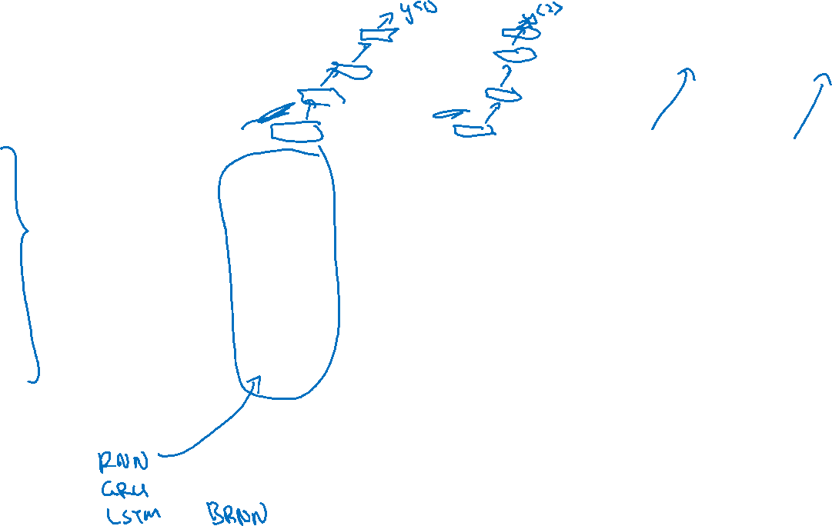
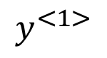
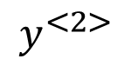
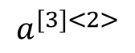
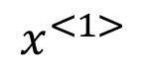
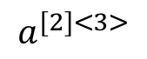
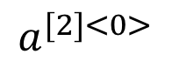
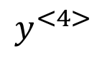
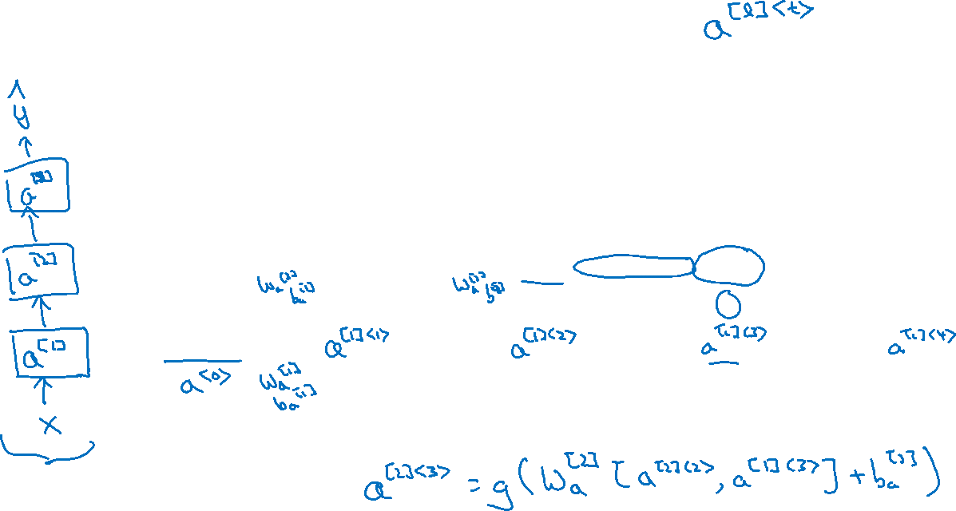
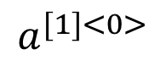
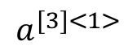
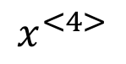
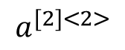
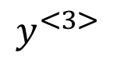
Deep RNN example
$$y^{<1>}$$
$$y^{<2>}$$
$$y^{<3>}$$
$$y^{<4>}$$
$$a^{[3]<0>}$$
$$a^{[3]<1>}$$
$$a^{[3]<2>}$$
$$a^{[3]<3>}$$
$$a^{[3]<4>}$$
$$a^{[2]<0>}$$
$$a^{[2]<1>}$$
$$a^{[2]<2>}$$
$$a^{[2]<3>}$$
$$a^{[2]<4>}$$
$$a^{[1]<0>}$$
$$x^{<1>}$$
$$x^{<2>}$$
$$x^{<3>}$$
$$x^{<4>}$$

Slide 38
NLP and Word Embeddings
Word representation
deeplearning.ai

Slide 39
Word representation
V = [a, aaron, …, zulu, <UNK>]
1-hot representation
Man
(5391)
Woman
(9853)
King
(4914)
Queen
(7157)
Apple
(456)
Orange
(6257)
I want a glass of orange ______.
I want a glass of apple______.
$$\left[\begin{aligned}\begin{matrix}0 \\ 0 \\ 0\end{matrix} \\ 0 \\ ⋮ \\ 1 \\ ⋮ \\ 0 \\ 0\end{aligned}\right]$$
$$\left[\begin{aligned}\begin{matrix}0 \\ 0 \\ 0\end{matrix} \\ 0 \\ 0 \\ ⋮ \\ 1 \\ ⋮ \\ 0\end{aligned}\right]$$
$$\left[\begin{aligned}\begin{matrix}0 \\ 0 \\ 0\end{matrix} \\ ⋮ \\ 1 \\ ⋮ \\ 0 \\ 0 \\ 0\end{aligned}\right]$$
$$\left[\begin{aligned}\begin{matrix}0 \\ 0 \\ 0\end{matrix} \\ 0 \\ 0 \\ ⋮ \\ 1 \\ ⋮ \\ 0\end{aligned}\right]$$
$$\left[\begin{aligned}\begin{matrix}0 \\ ⋮ \\ 1\end{matrix} \\ ⋮ \\ 0 \\ 0 \\ 0 \\ 0 \\ 0\end{aligned}\right]$$
$$\left[\begin{aligned}\begin{matrix}0 \\ 0 \\ 0\end{matrix} \\ 0 \\ 0 \\ ⋮ \\ 1 \\ ⋮ \\ 0\end{aligned}\right]$$

Slide 40
Featurized representation: word embedding
Man
(5391)
Woman
(9853)
King
(4914)
Queen
(7157)
Apple
(456)
Orange
(6257)
-0.95
$$0.97$$
0.00
0.01
0.93
$$0.95$$
-0.01
0.00
0.7
0.69
0.03
-0.02
0.02
0.01
0.95
0.97
I want a glass of orange ______.
I want a glass of apple______.

Slide 41
Visualizing word embeddings
man
woman
dog
king
cat
queen
fish
apple
grape
three
four
one
orange
two
[van der Maaten and Hinton., 2008. Visualizing data using t-SNE]

Slide 42
NLP and Word Embeddings
Using word embeddings
deeplearning.ai

Slide 43
Named entity recognition example
$$1$$
$$1$$
$$0$$
$$0$$
$$0$$
$$0$$
Sally Johnson is an orange farmer
Robert Lin is an apple farmer

Slide 44
Transfer learning and word embeddings
Learn word embeddings from large text corpus. (1-100B words)
(Or download pre-trained embedding online.)
2. Transfer embedding to new task with smaller training set.
(say, 100k words)
3. Optional: Continue to finetune the word embeddings with new
data.

Slide 45
Relation to face encoding
$$⋮$$
$$x^{(i)}$$
$$f(x^{(i)})$$
$$\hat{y}$$
$$⋮$$
$$⋮$$
$$x^{(j)}$$
$$f(x^{(j)})$$
[Taigman et. al., 2014. DeepFace: Closing the gap to human level performance]

Slide 46
NLP and Word Embeddings
Properties of word embeddings
deeplearning.ai

Slide 47
Analogies
Man
(5391)
Woman
(9853)
King
(4914)
Queen
(7157)
Apple
(456)
Orange
(6257)
Gender
$$−1$$
1
-0.95
$$0.97$$
0.00
0.01
Royal
$$0.01$$
0.02
0.93
$$0.95$$
-0.01
0.00
Age
0.03
0.02
0.70
0.69
0.03
-0.02
Food
0.09
0.01
0.02
0.01
0.95
0.97
[Mikolov et. al., 2013, Linguistic regularities in continuous space word representations]

Slide 48
Analogies using word vectors
man
woman
dog
king
cat
queen
fish
three
four
apple
grape
one
two
orange
$$e_{man}−e_{woman}≈e_{king}−e_{?}$$

Slide 49
Cosine similarity
$$sim(e_{w}, e_{king}−e_{man}+e_{woman})$$
Man:Woman as Boy:Girl
Ottawa:Canada as Nairobi:Kenya
Big:Bigger as Tall:Taller
Yen:Japan as Ruble:Russia

Slide 50
NLP and Word Embeddings
Embedding matrix
deeplearning.ai

Slide 51
Embedding matrix
In practice, use specialized function to look up an embedding.

Slide 52
NLP and Word Embeddings
Learning word embeddings
deeplearning.ai

Slide 53
Neural language model
I want a glass of orange ______.
$$4343$$
$$9665$$
$$1$$
$$3852$$
$$6163$$
$$6257$$
I
$$o_{4343}$$
$$E$$
$$e_{4343}$$
want
$$o_{9665}$$
$$E$$
$$e_{9665}$$
a
$$o_{1}$$
$$E$$
$$e_{1}$$
glass
$$o_{3852}$$
$$E$$
$$e_{3852}$$
of
$$o_{6163}$$
$$E$$
$$e_{6163}$$
orange
$$o_{6257}$$
$$E$$
$$e_{6257}$$
[Bengio et. al., 2003, A neural probabilistic language model]

Slide 54
Other context/target pairs
I want a glass of orange juice to go along with my cereal.
Context: Last 4 words.
4 words on left & right
Last 1 word
Nearby 1 word

Slide 55
NLP and Word Embeddings
Word2Vec
deeplearning.ai

Slide 56
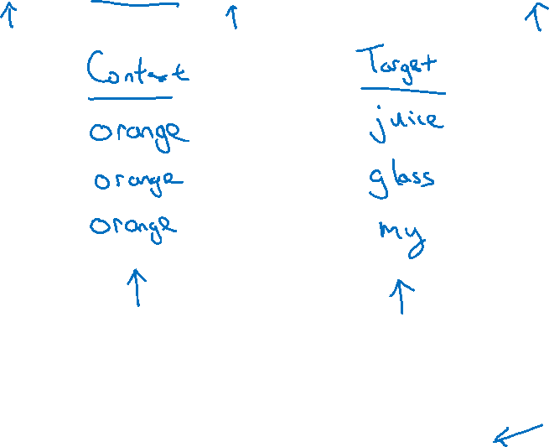
Skip-grams
I want a glass of orange juice to go along with my cereal.
[Mikolov et. al., 2013. Efficient estimation of word representations in vector space.]

Slide 57
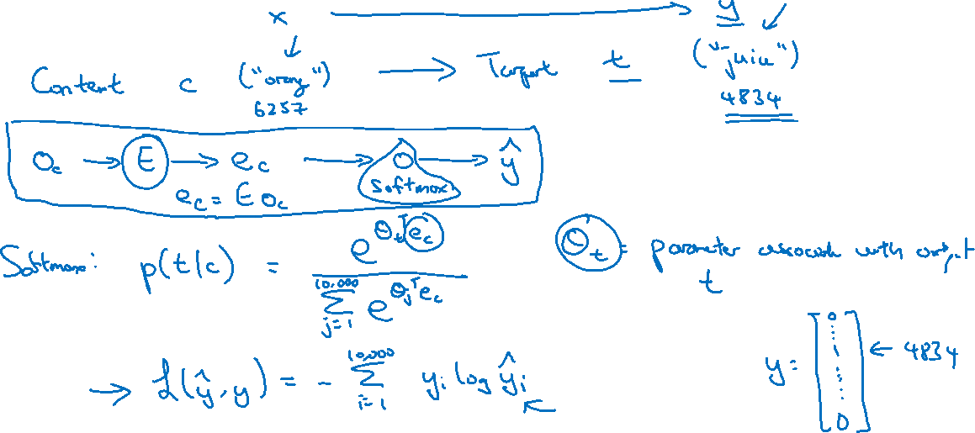
Model
Vocab size = 10,000k

Slide 58
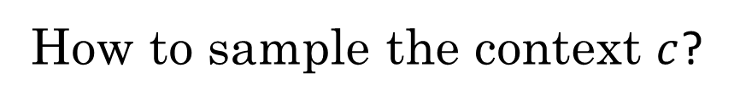
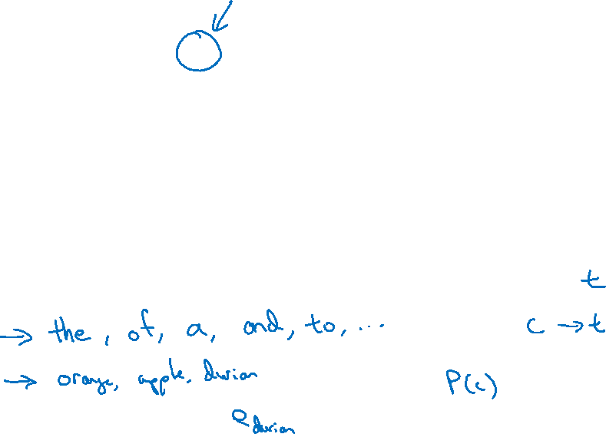
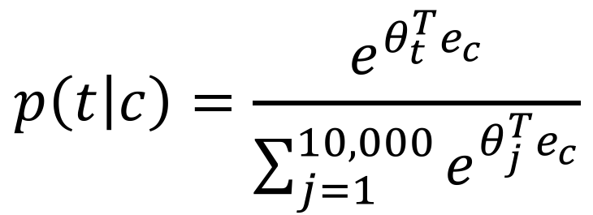
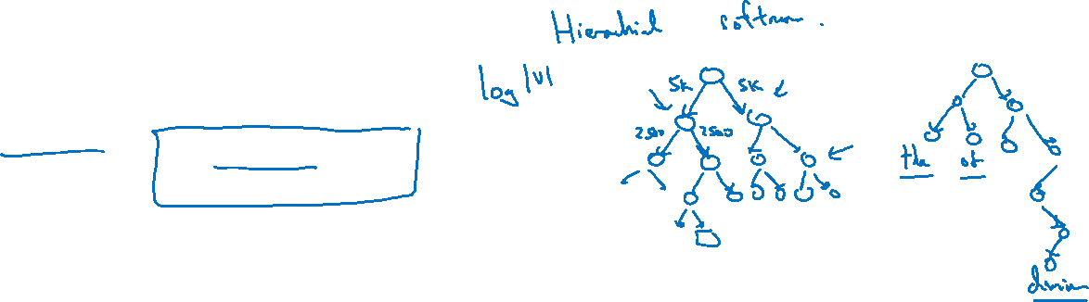
Problems with softmax classification
$$p\left(t | c\right)=\frac{e^{θ_{t}^{T}e_{c}}}{\sum_{j=1}^{10,000}{e^{θ_{j}^{T}e_{c}}}}$$
How to sample the context $c$?

Slide 59
NLP and Word Embeddings
Negative sampling
deeplearning.ai

Slide 60
Defining a new learning problem
I want a glass of orange juice to go along with my cereal.
[Mikolov et. al., 2013. Distributed representation of words and phrases and their compositionality]

Slide 61
Model
$$p\left(t | c\right)=\frac{e^{θ_{t}^{T}e_{c}}}{\sum_{j=1}^{10,000}{e^{θ_{j}^{T}e_{c}}}}$$
Softmax:
context
word
target?
orange
juice
$$1$$
orange
king
$$0$$
orange
book
$$0$$
orange
the
$$0$$
orange
of
$$0$$

Slide 62
Selecting negative examples
context
word
target?
orange
juice
$$1$$
orange
king
$$0$$
orange
book
$$0$$
orange
the
$$0$$
orange
of
$$0$$

Slide 63
NLP and Word Embeddings
GloVe word vectors
deeplearning.ai

Slide 64
GloVe (global vectors for word representation)
I want a glass of orange juice to go along with my cereal.
[Pennington et. al., 2014. GloVe: Global vectors for word representation]

Slide 65
Model

Slide 66
A note on the featurization view of word embeddings
Man
(5391)
Woman
(9853)
King
(4914)
Queen
(7157)
Gender
$$−1$$
1
-0.95
$$0.97$$
Royal
$$0.01$$
0.02
0.93
$$0.95$$
Age
0.03
0.02
0.70
0.69
Food
0.09
0.01
0.02
0.01
m$inimize \sum_{i=1}^{10,000}{\sum_{j=1}^{10,000}{f\left(X_{ij}\right){\left(θ_{i}^{T}e_{j}+b_{i}−b_{j}^{′}−\log{X_{ij}}\right)}^{2}}}$

Slide 67
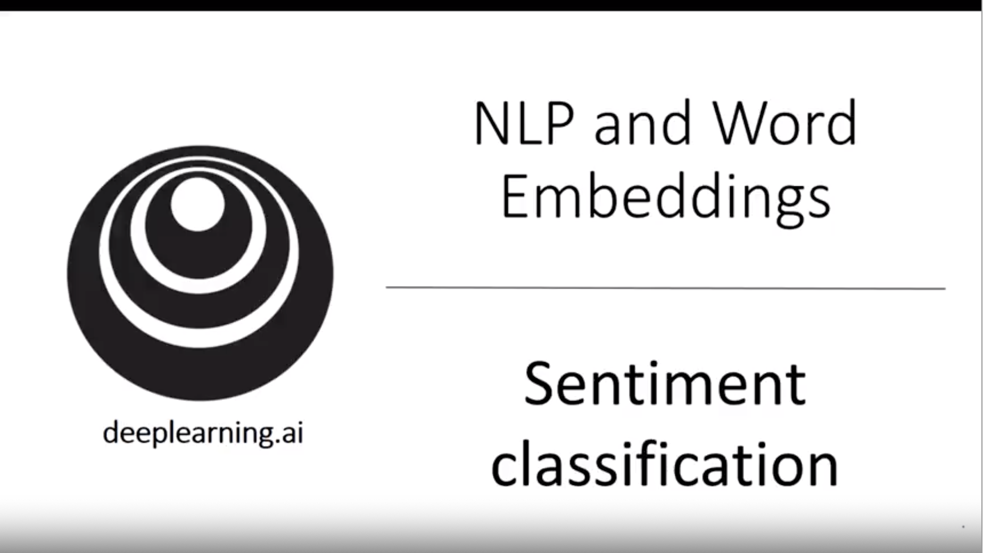

Slide 68
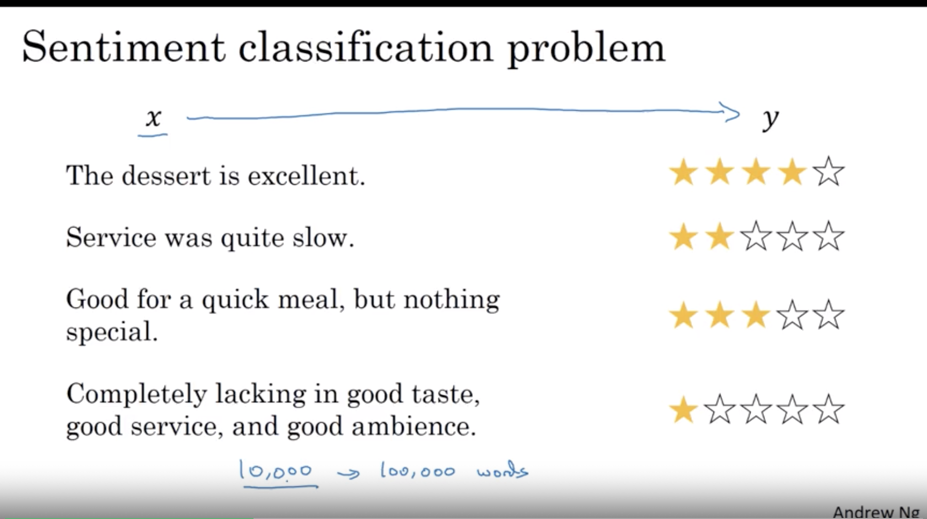

Slide 69
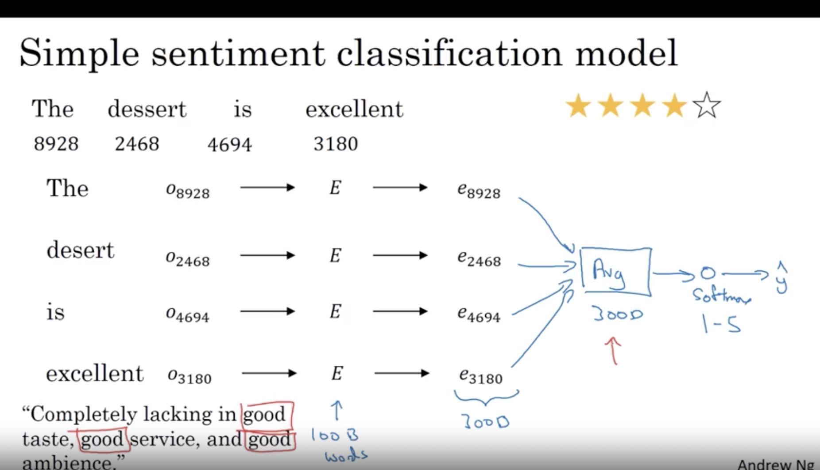

Slide 70
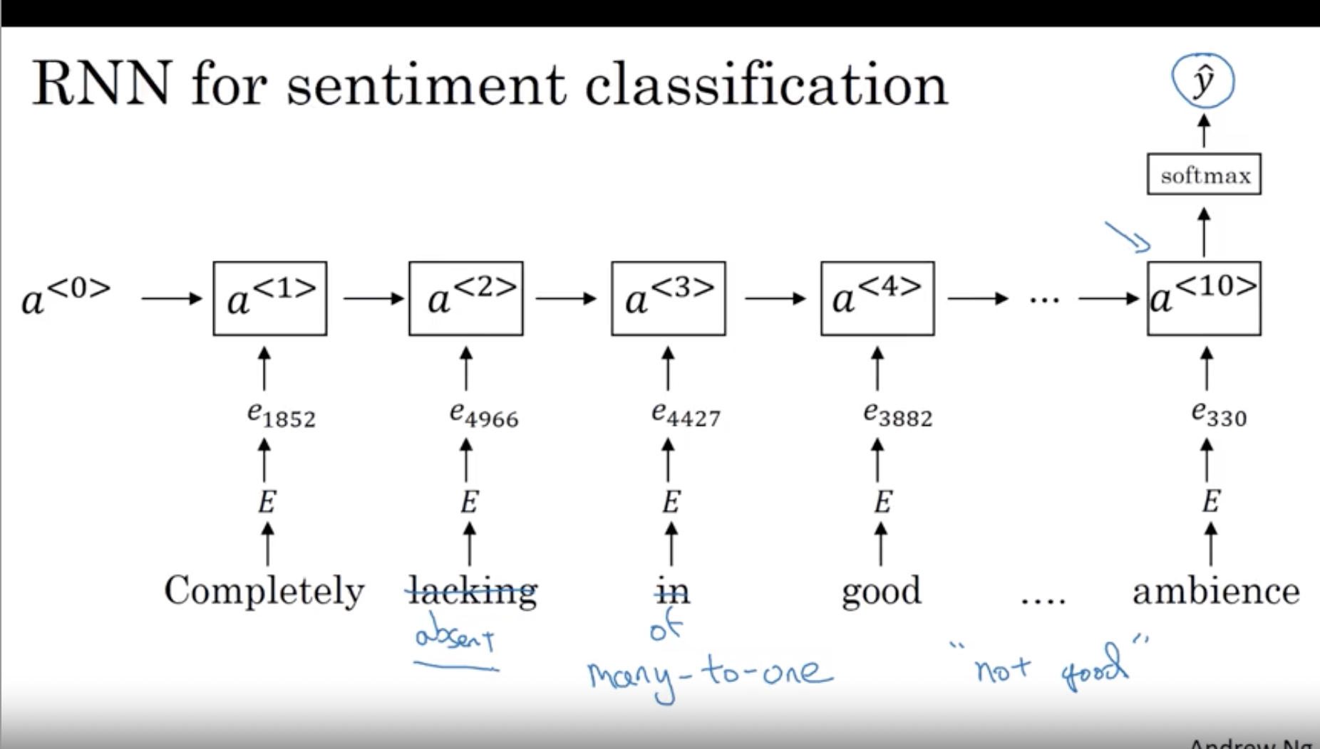

Slide 71
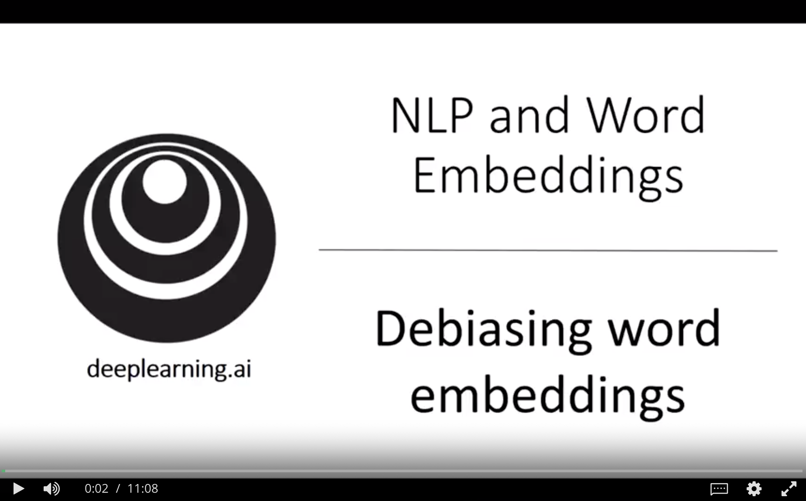

Slide 72
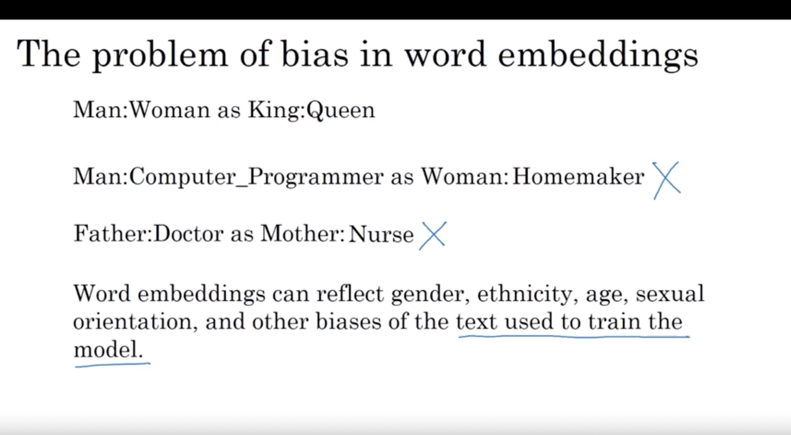

Slide 73
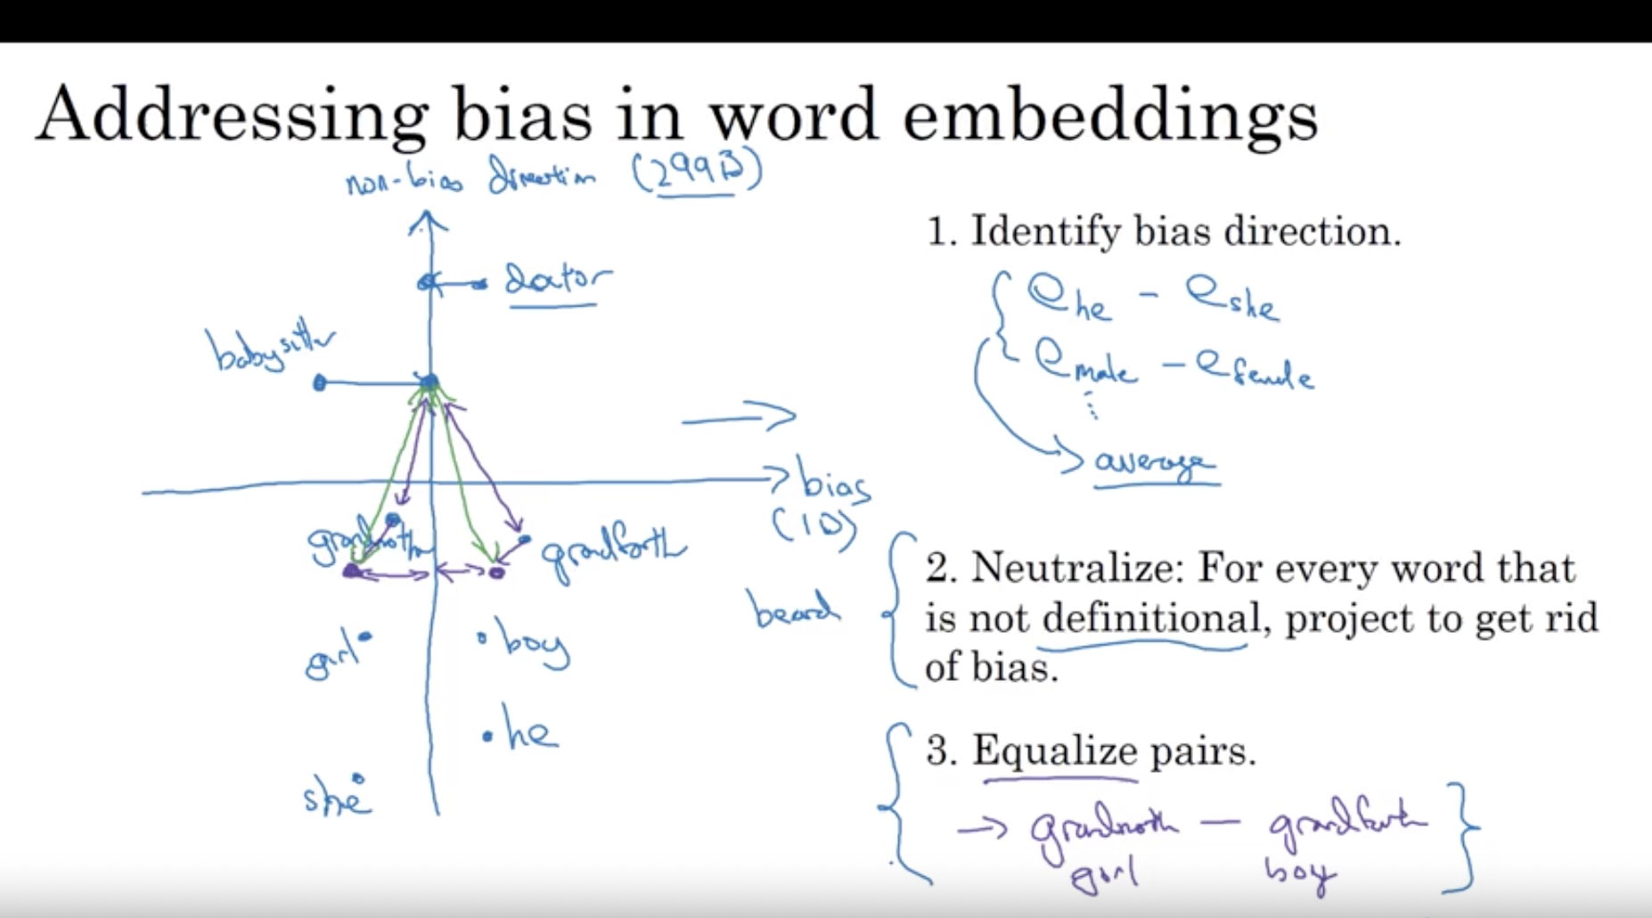

Slide 74
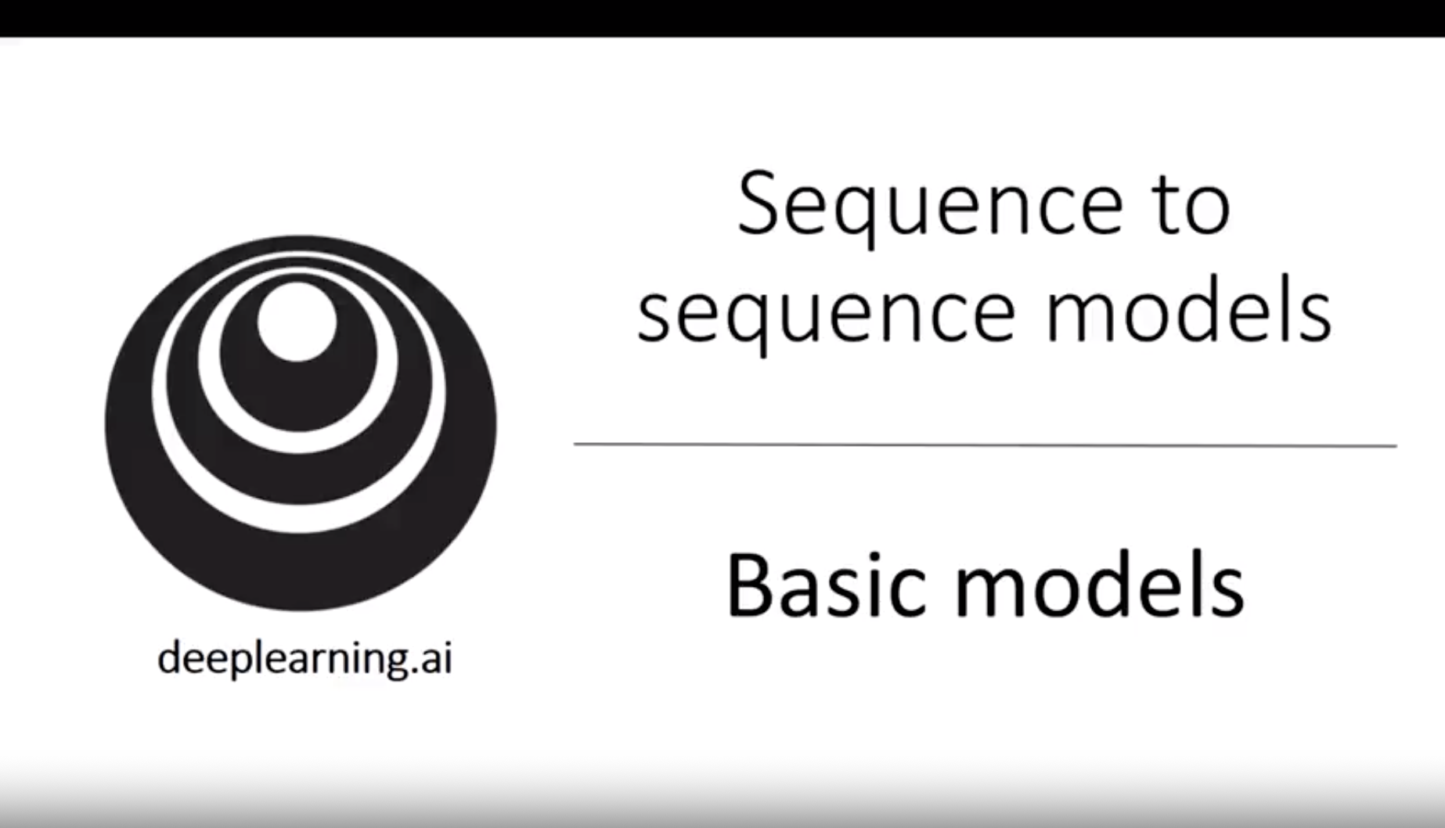

Slide 75
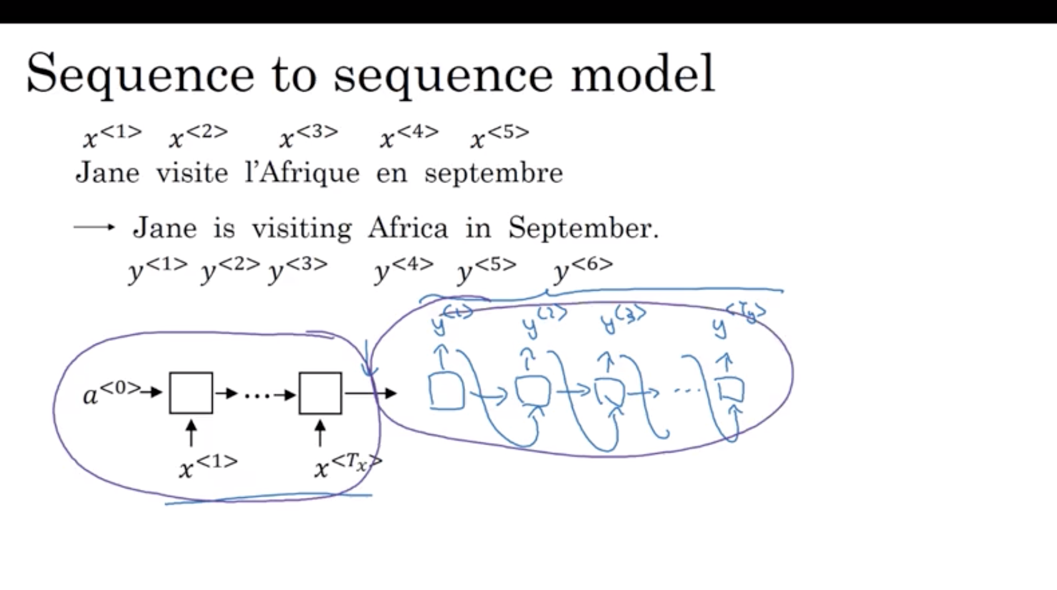

Slide 76


Slide 77


Slide 78


Slide 79


Slide 80


Slide 81


Slide 82


Slide 83


Slide 84


Slide 85


Slide 86


Slide 87


Slide 88


Slide 89


Slide 90


Slide 91


Slide 92


Slide 93


Slide 94


Slide 95


Slide 96


Slide 97


Slide 98


Slide 99


Slide 100


Slide 101


Slide 102


Slide 103


Slide 104


Slide 105


Slide 106


Slide 107


Slide 108


Slide 109


